Slide 1


Innolab GPT
A personal Chatbot
Is all your need

Slide 2
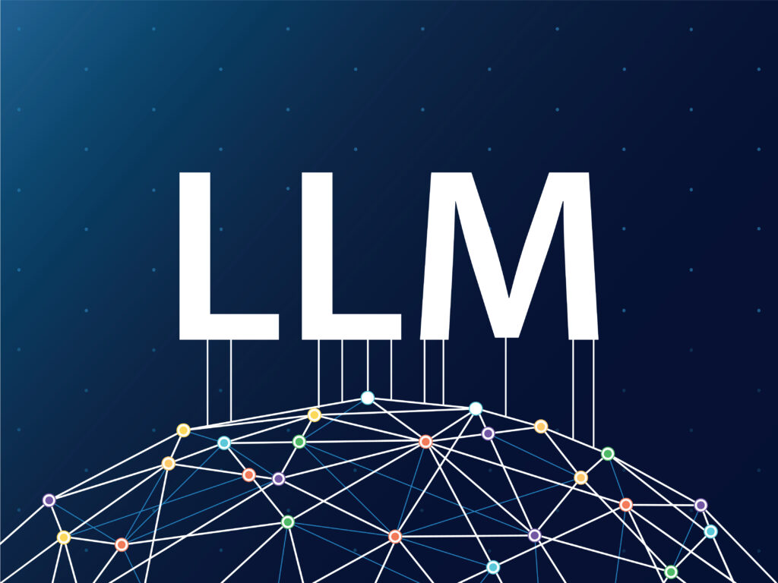
What can LLMs do?

Slide 3



Our Team
Panda Tam
TSD Intern
Kenny Wan
TSD Intern
Axis Chia
TSD Intern

Slide 4
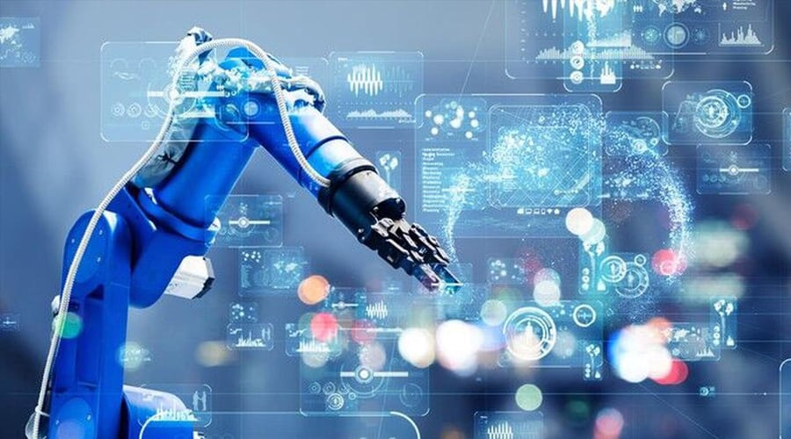

Problem Statement
Chatbot not knowing what you need
Suggestions are not personalized
Chatbot lacks automation

Slide 5
LangChain Features
📃 LLMs and Prompts:
LangChain provides prompt management, optimization, and a generic interface for all LLMs.
🔗 Chains:
Chains go beyond a single LLM call and involve sequences of calls.
LangChain provide chains for connecting different tools and do the task step by step.
🤖 Agents:
Agents helps LLM to do decision when answering the question.
LangChain provide Agent's template, like how it should think, input and output.
🧠 Memory:
Memory refers to persisting state between calls of a chain/agent.
LangChain provide memory for conversation, so it will know what is talking in previous chat.

Slide 6
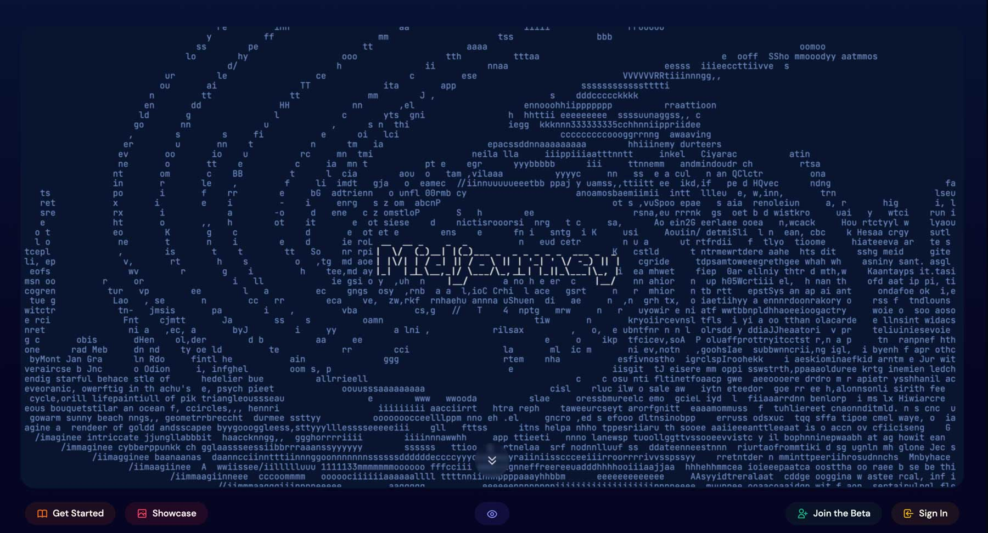
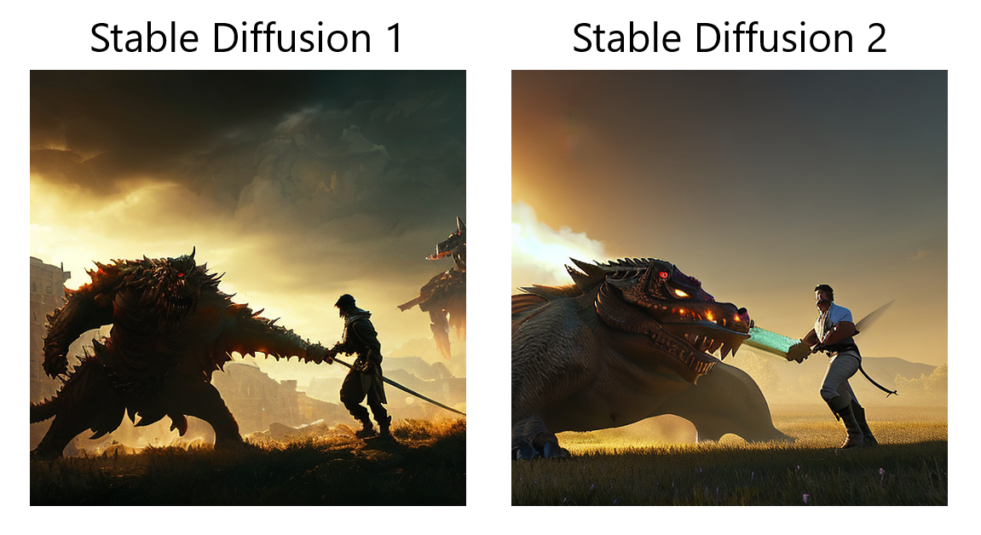
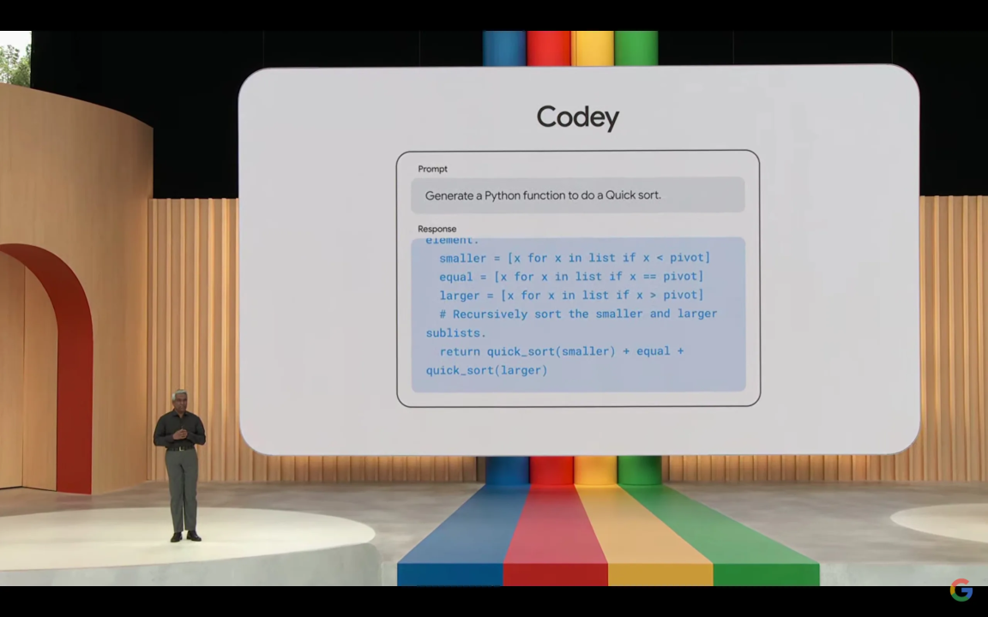
Not Only Text
Images: Mid-journey
Midjourney is an AI tools that can create images from text
Images: Stable diffusion
Stable Diffusion Model is a latent tex-to-image diffusion model.
Coding: codey
Google's Codey is powered by PaLM 2 for generation, completion, debugging, learning and code assistance

Slide 7
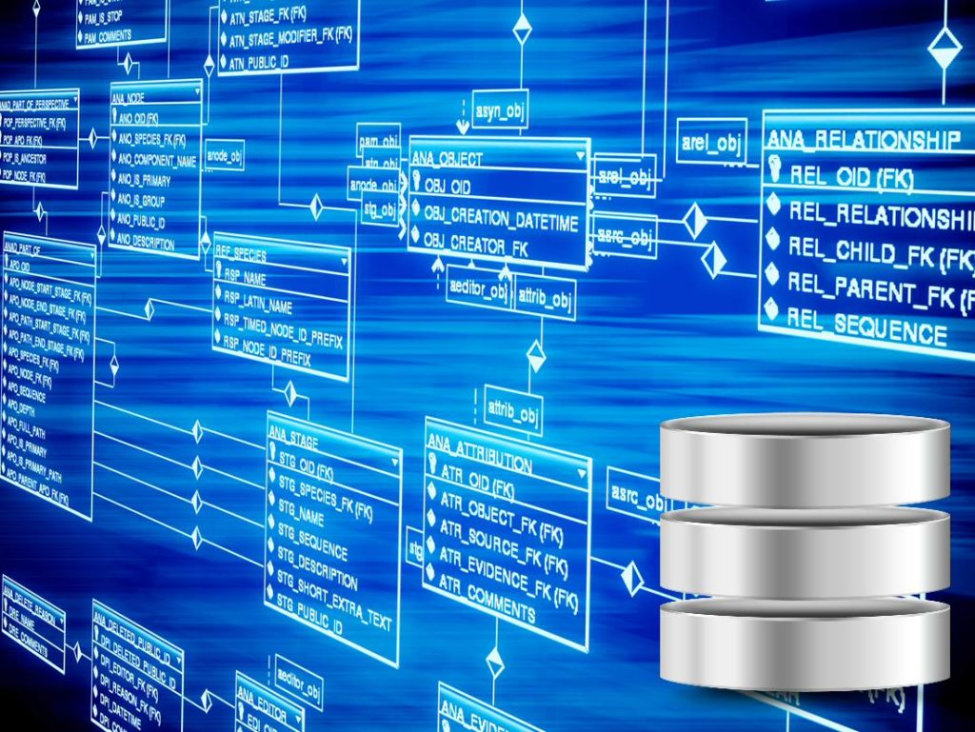
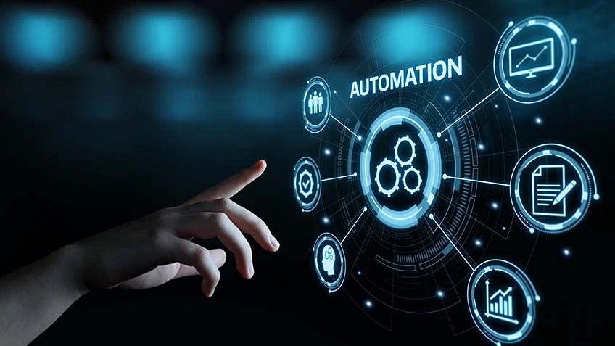

Your personal AI assistant
Personal assistant
have background knowledge about you
Can make unique, personal answer
Personal Document
Knowledge DataBase
Can freely build and edit your own database
Vector search on database and use llm to answer
Automation
Auto Email generation
Auto Email Send

Slide 8
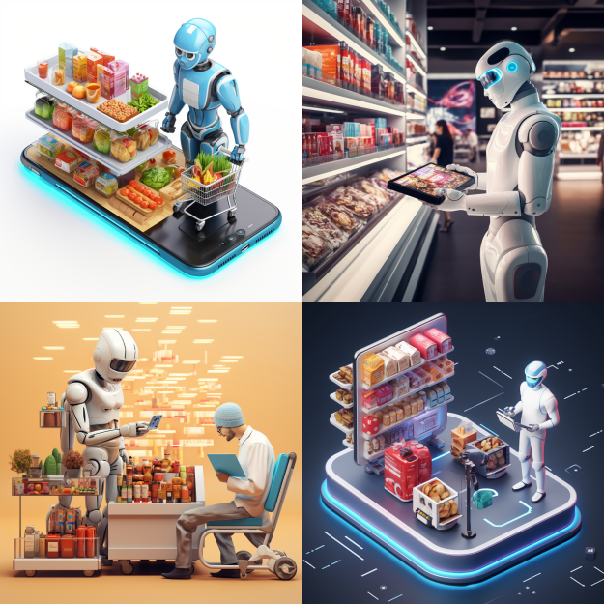
Life Pal
merge the database of company products
Can promote the product to the user when suitable

Slide 9
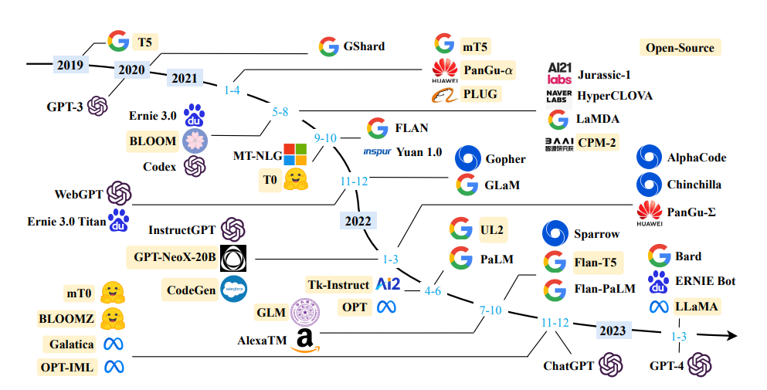
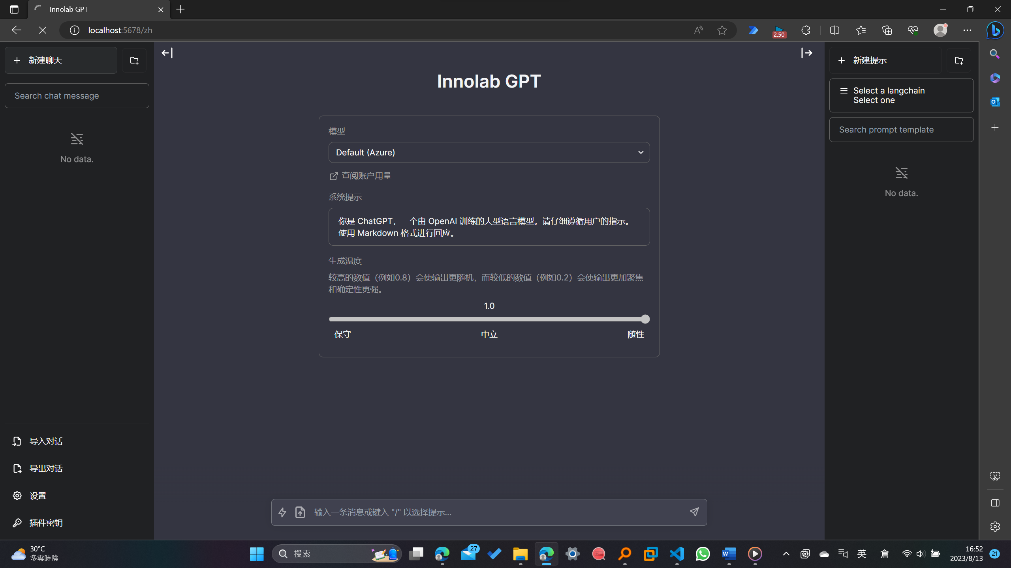
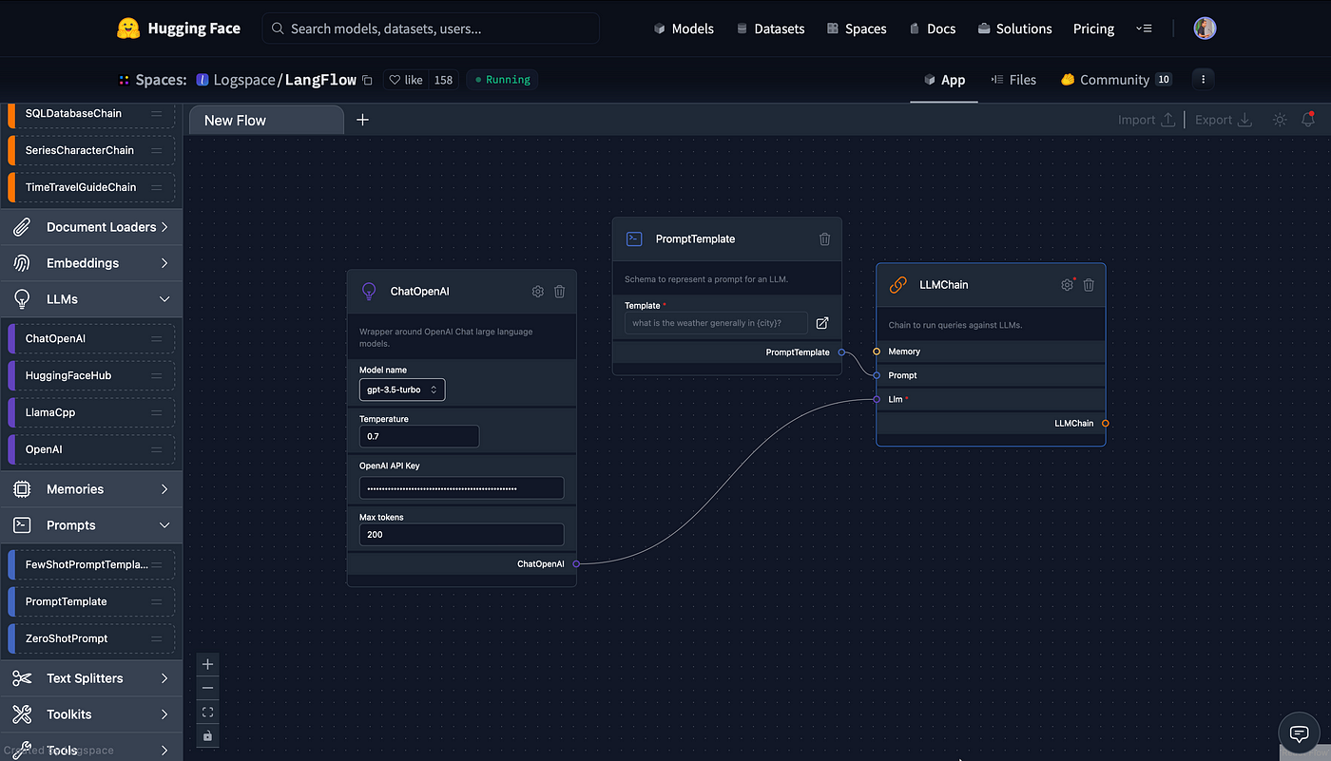
Support different LLMs selection
Support multiple access platform
Build your own LLMs application !​
The user can choose different LLMs to answer
Vicuna, Azure OpenAI, GoRoboto Lightogle PaLM2
Website UI
Through virtual agents, connect to Teams bot
Langflow – a graphic interface for Langchain​
Just by drag and drop

Slide 10
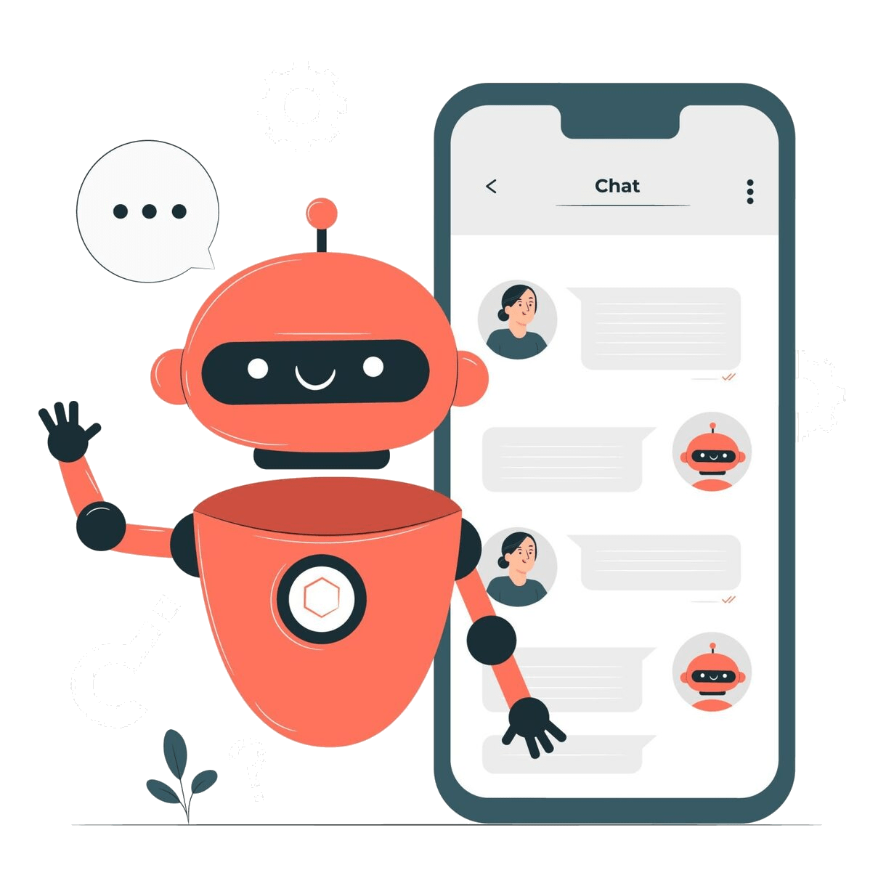
Use Case
Personalize:
Imagine you want to boost your productivity with chatbots, but no matching tools

Slide 11
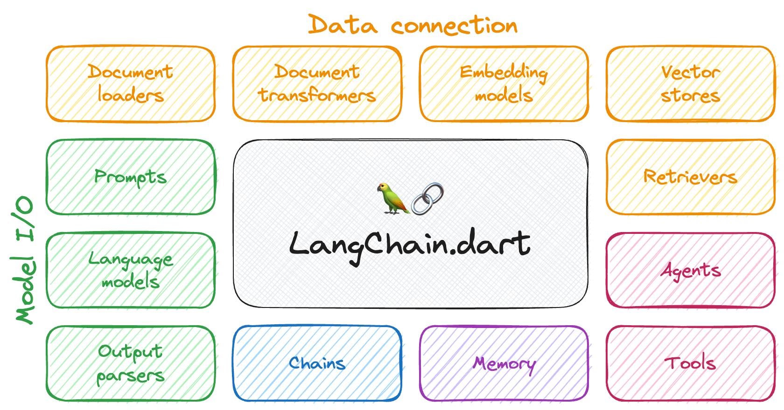
Use Case
Personalize:
Use pre-default or customize your own LangChain workflow for your own needs!

Slide 12
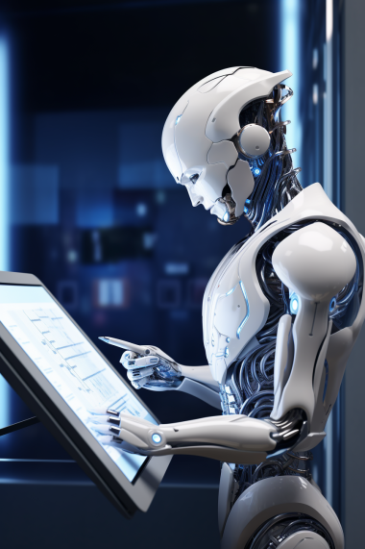
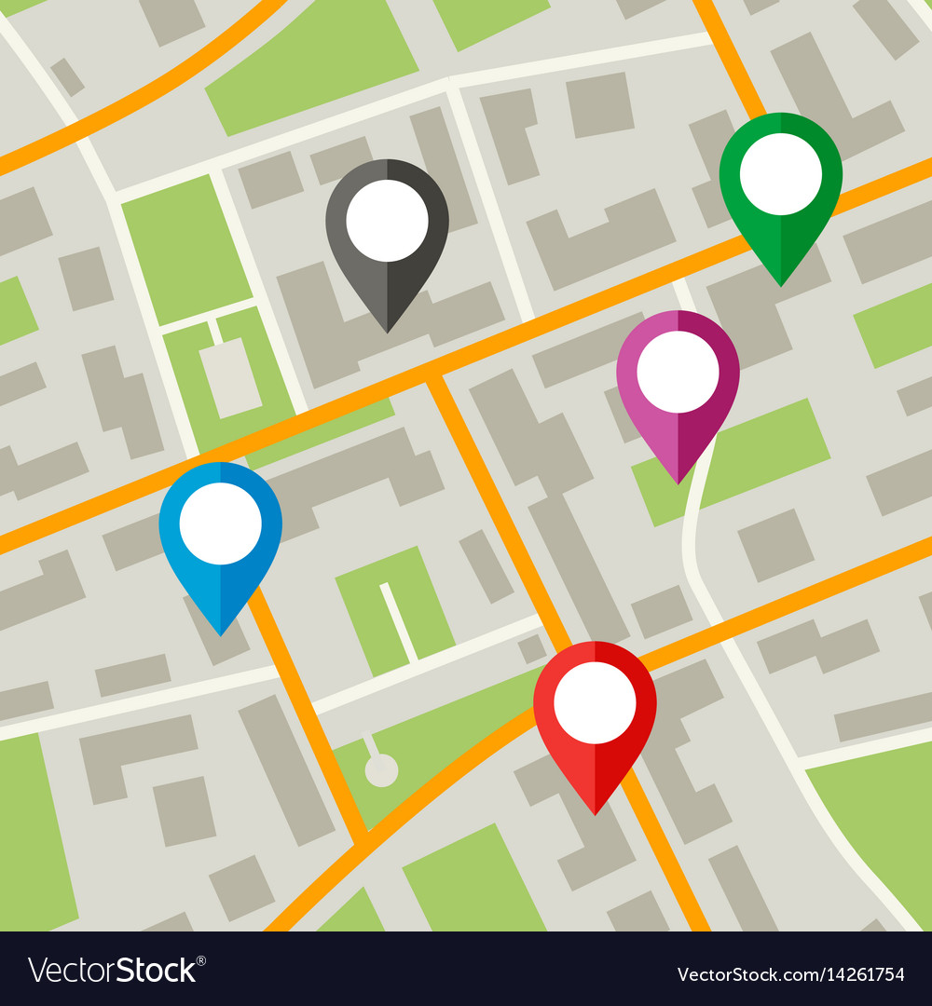
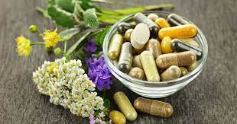
Use Case
Automation:
Locate nearby clinics
Fill in forms and make clinic appointment automatically
Recommend medicines and supplement base on users’ situation, age, gender and other personal factors

Slide 13

Use Case
Automation:
Imagine you are sick, you want the AI to automate everything

Slide 14
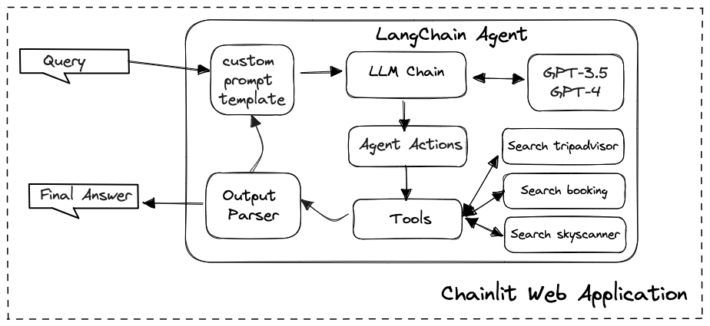
Langchain
Reference: Level Up Coding

Slide 15
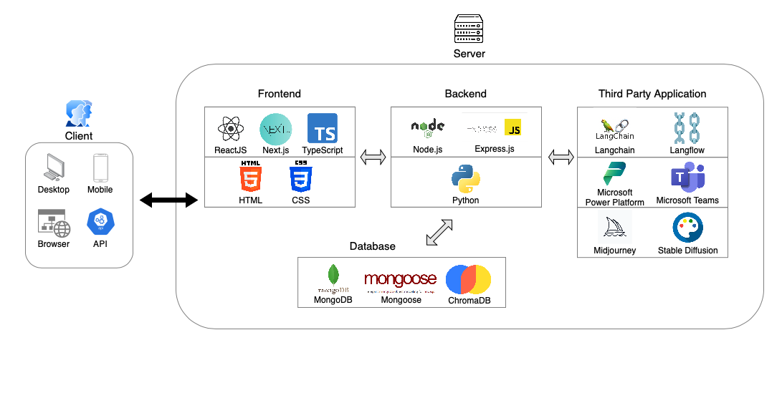
System Architecture
Notes:
Briefly explain the use of different languages in our website

Slide 16
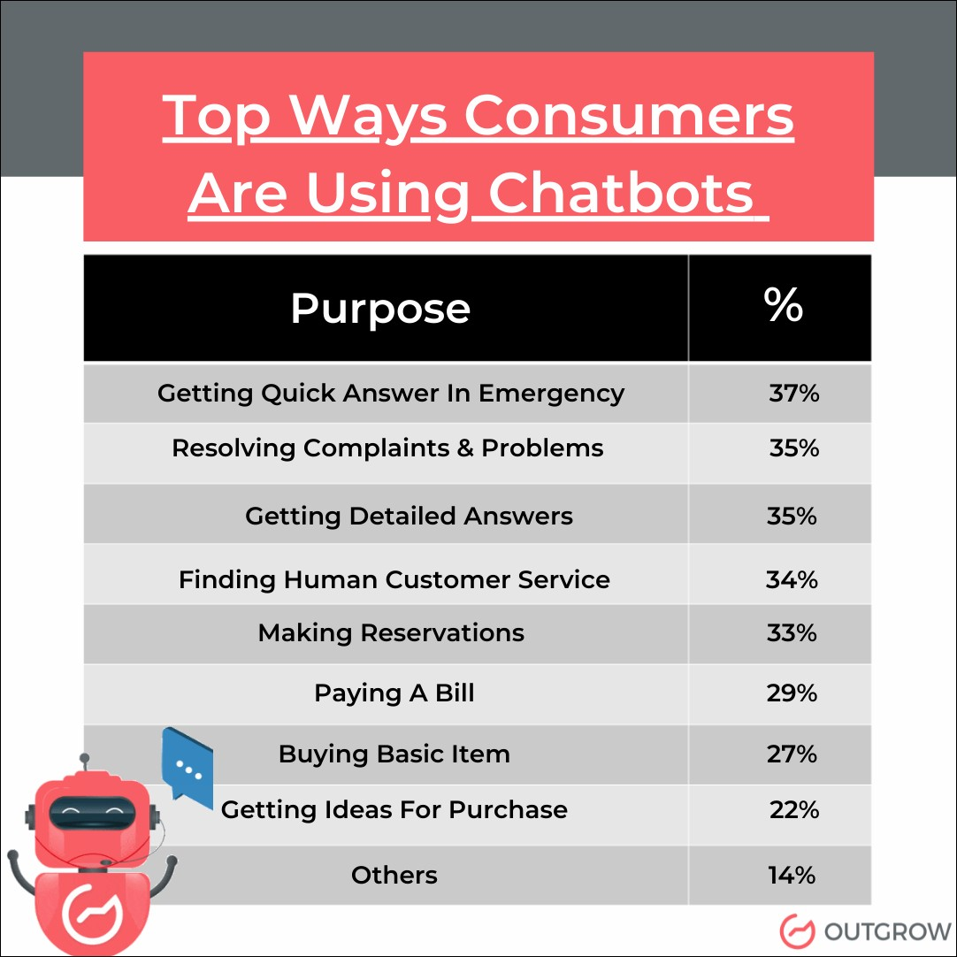
Market Potential
Market need of Customized Personal Assistant:
Imagine an assistant knows you well, who can give you most suitable advices rapidly
Reference: Outgrow (2023)

Slide 17
Market Potential
Market need of Automation Assistant:
Imagine an assistant knows you well, who can perform tasks with your personal information automatically
Reference: Outgrow (2023)

Slide 18
Demo Session

Slide 19
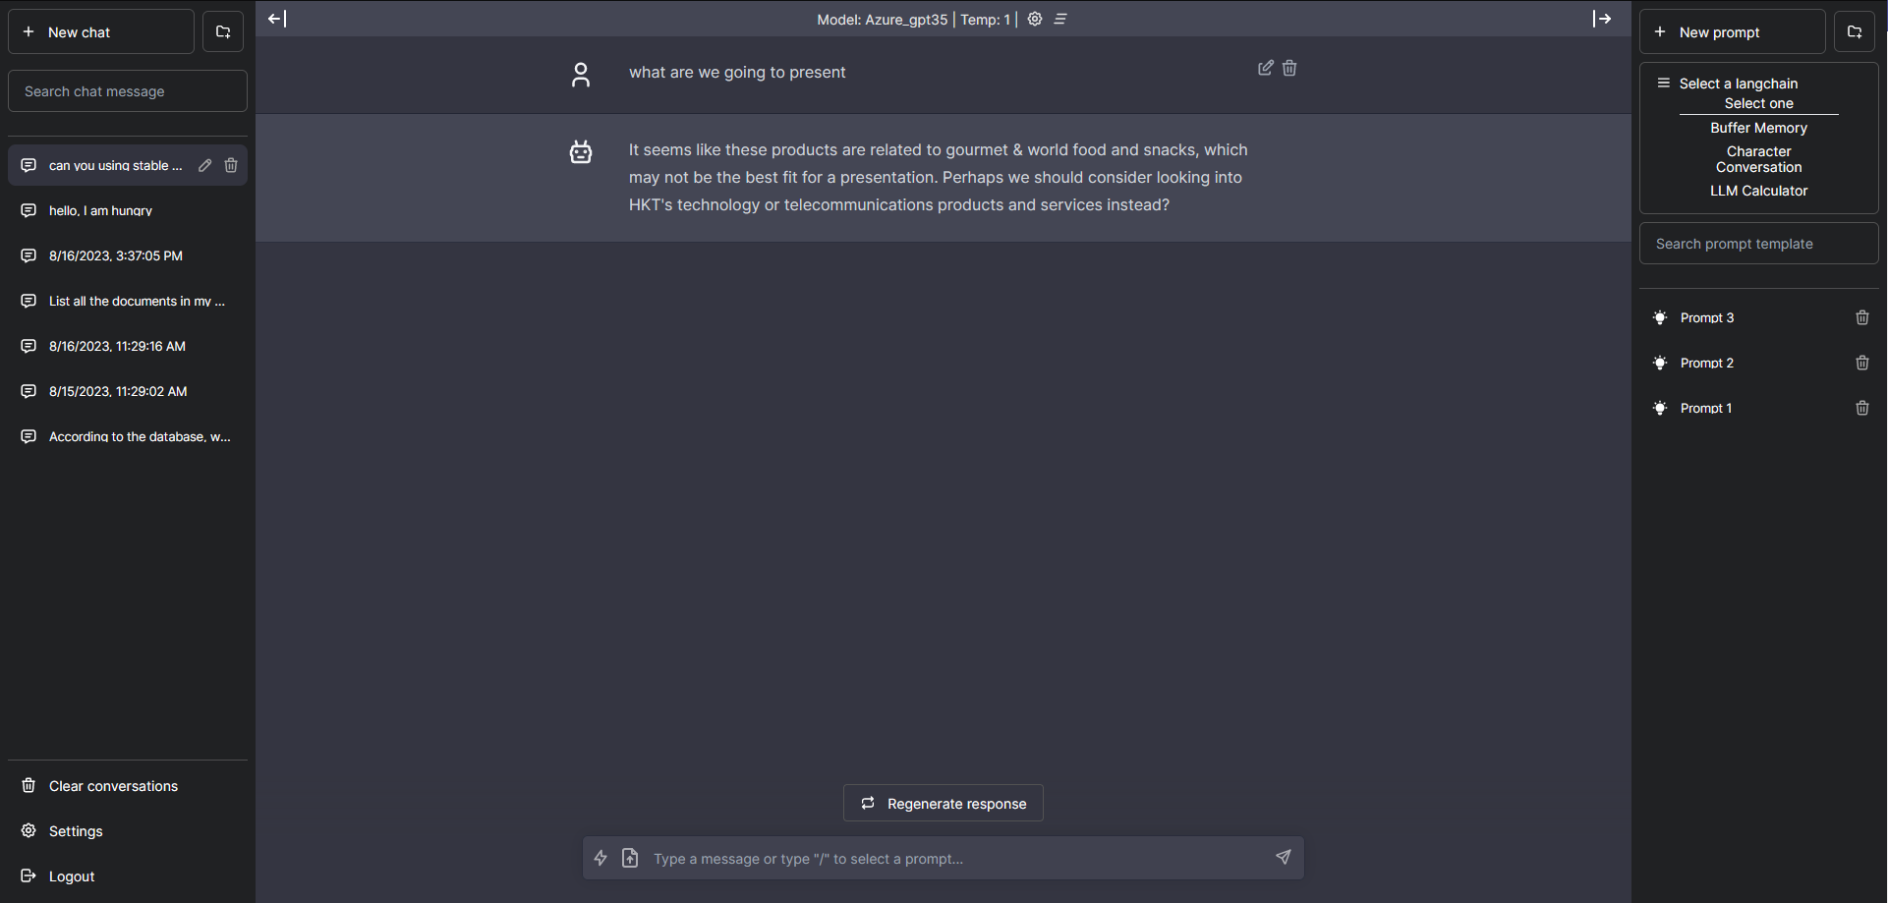
Langflow options
Conversion history
File uploader
Send prompt

Slide 20
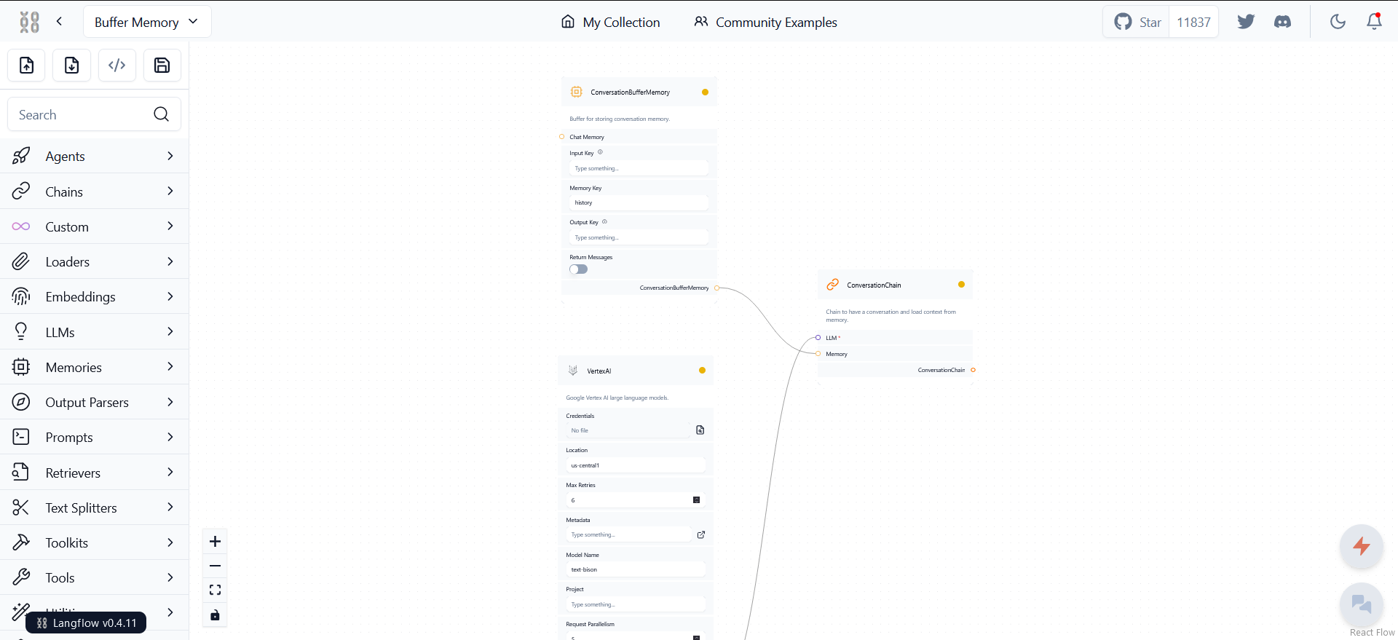
Fully customizable tools
1.Click to compile the chatbot in Langflow
2.Once it is finished, click on this button to start the conversation

Slide 21
Q&A Session

